Slide 1
2021 Annual Report
For the year ending December 31, 2021
2019-2027 Strategic Plan Priorities

Slide 2







Our 2021 Performance Story
Advancement of Strategic Plan priorities
Accomplishments and priority
projects
Awards and recognition
Financial information and audited
statements
Notes:
Follow up to audited financial statements, presented at Audi committee last month. This is the performance story.

Slide 3

Measuring Our Performance
Quarterly Performance Dashboard
World Council on City Data
BMA Management Consulting Inc. Study
Municipal Benchmarking Network of Canada

Slide 4





2021 Awards and Recognition
Financial excellence
Regreening
Water/wastewater innovation
Communications and public engagement

Slide 5






2021 Highlights: By Numbers
$144 M
capital program
10
new GOVA buses
+ 23% in ridership
48
major land use
planning applications
215
newcomers
welcomed
$87 M construction value tendered
7,650 m
active transportation added
20
two-bedroom housing
units converted
142
people added to By-Name list with 55 housed
Notes:
10 new GOVA buses and 23% increase in ridership
48 major land use planning applications reviewed
$291 million in construction value
215 newcomers welcomed
7,650 metres of active transportation added
20 two-bedroom housing units converted
142 people added to By-Name list with 55 housed or no longer requiring housing supports

Slide 6







2021 Highlights: COVID-19 Response
Communications and education
Leadership through partnerships
Critical Support for vaccination program
Adaptation of existing services
Addition of new and enhanced services
Emphasis on supporting people experiencing homelessness
Notes:
Communications and education
Leadership through partnerships
Critical Support for community vaccination program
Adaptation of existing services
Addition of new and enhanced services
Emphasis on supporting people experiencing homelessness

Slide 7




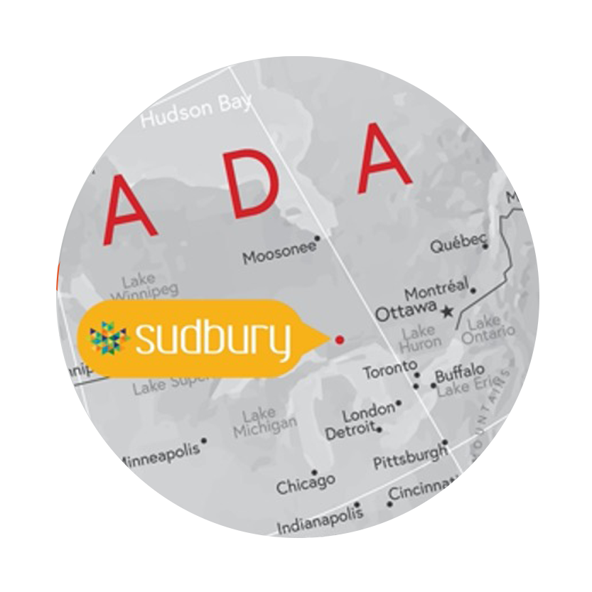
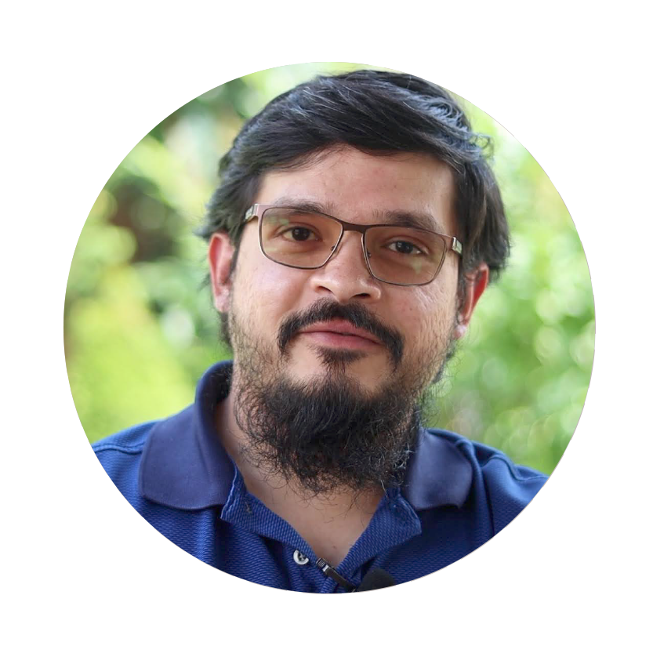

2021 Highlights: Community Initiatives
Indigenous relations staff liaison
Encampment Strategy
Population Health, Community Safety and
Well-Being Plan
Ontario Job Site Challenge
Rural and Northern Immigration Pilot program
Community Energy and
Emissions Plan partnerships
Notes:
Indigenous relations staff liaison
Encampment Strategy
Population Health, Community Safety and Well-Being Plan
Ontario Job Site Challenge
Rural and Northern Immigration Pilot program
Community Energy and Emissions Plan partnerships

Slide 8
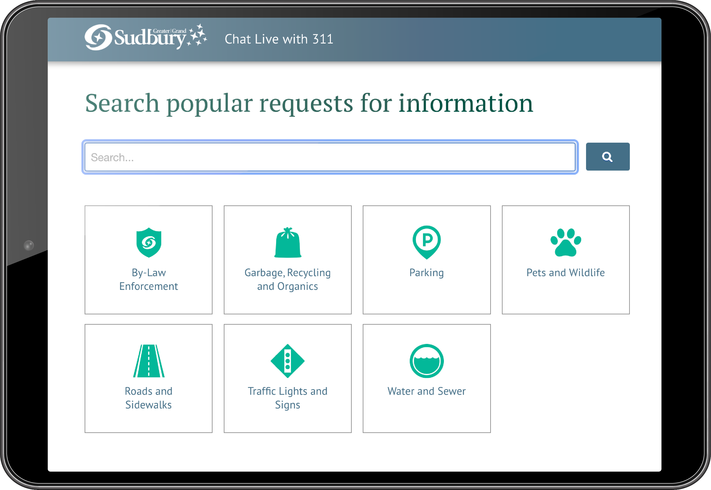

2021 Highlights: Priority Projects
Notes:
311 online portal
One-Stop Services counter construction
Hit Refresh Talent Attraction campaign
AMI water/meter project
Temporary supervised consumption site
Lorraine Street transitional housing project

Slide 9
2021 Highlights: Large Projects
Arena/Event Centre at the KED
Place des Arts
Junction East (Library/Art Gallery)
Junction West (Convention and Performance Centre)

Slide 10

2021 Financial Information Highlights
Performance Management
(MBNCAN/BMA Study)
Long term financial plan
Debt
Financing
Reserve and Reserve Funds
Development
Charges
Credit Rating
Budget
Water/
Wastewater Rates
User Fees
Variance
Reports
Notes:
$641 million operation
$144 capital
Standard and Poor’s AA credit rating
Enter. Risk Management framework
Secured low interest rate on Debt to address infrastructure requirement and key projects
Moved forward on Asset Management Plans
Increase to reserves and reservice funds by 5 %
$13 million increase in revenues
Decrease of $3 million for transportation
Increase of $4 million in social services offset by provincial funding
$70 million increase in accumulated surplus

Slide 11

greatersudbury.ca

