Slide 1
Proposed 2020 Budget
Presentation to Finance & Administration Committee
November 6, 2019
Ed Archer, Chief Administrative Officer

Slide 2

Harmonizing value, service and asset renewal

Slide 3






Investments In Our Community
$74.4 M for roads
$4.6 M for drainage projects
$20.4 M for roads winter maintenance
Red Light Camera enforcement
Flexibility achieved through Collective Bargaining

Slide 4
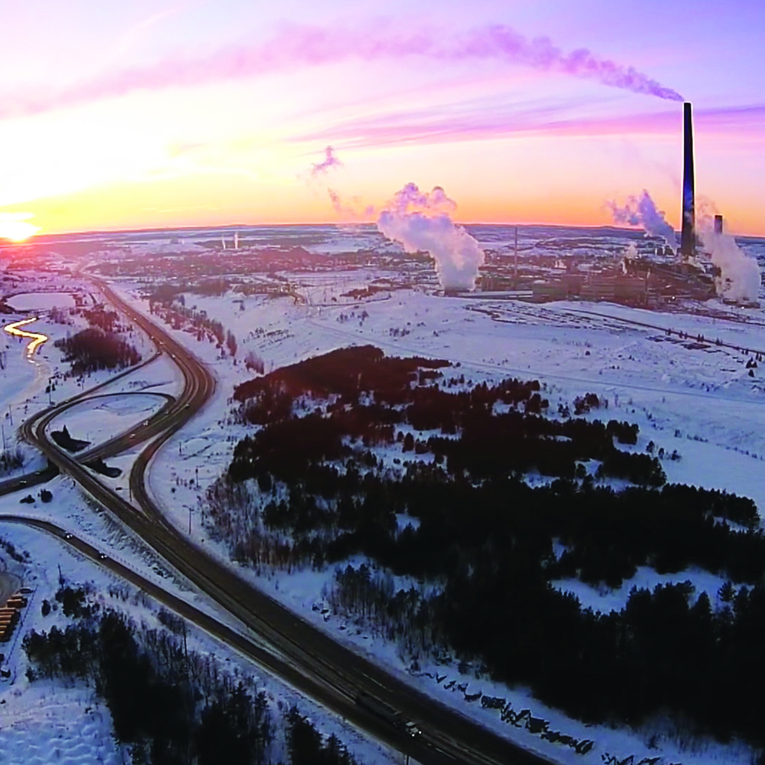
Our Mission
We work in partnership with
our community to provide
global leadership in technological, social and environmental development.

Slide 5
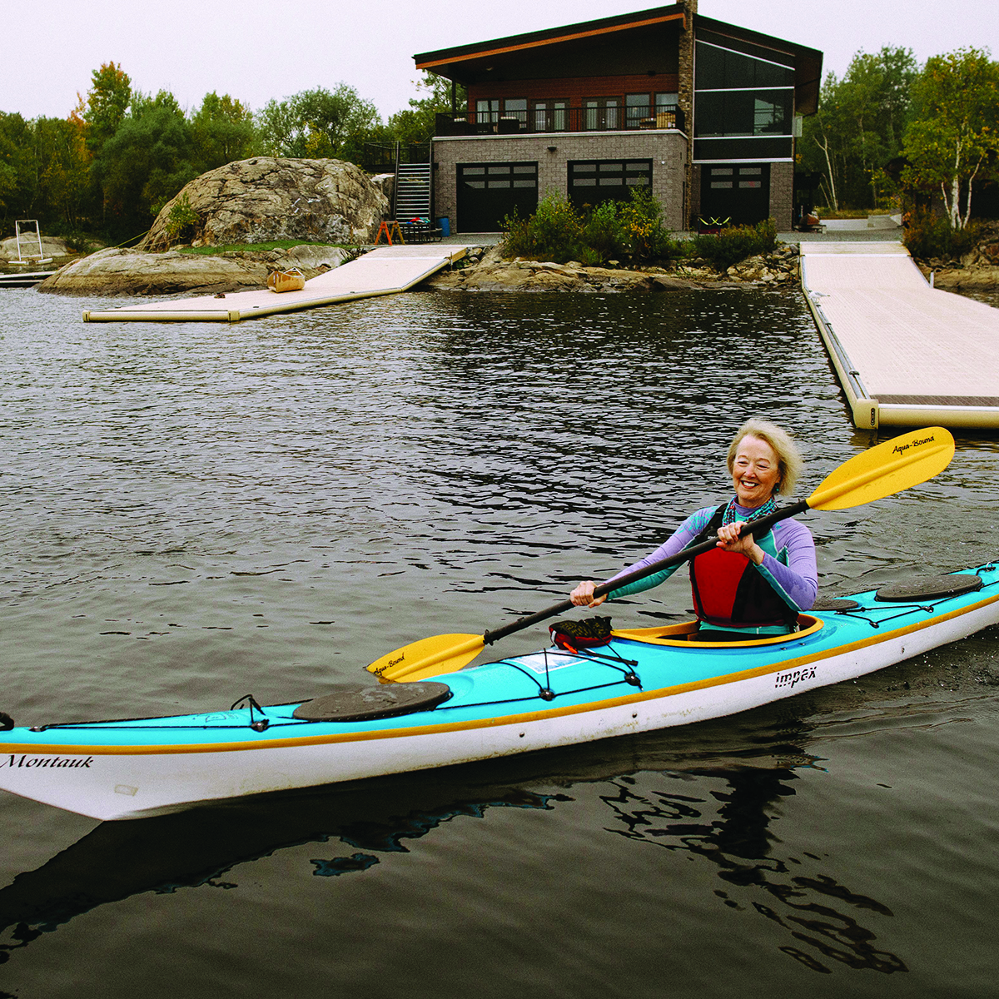
Our Mission
We build and foster a welcoming city that offers outstanding opportunity, wellness and value.

Slide 6
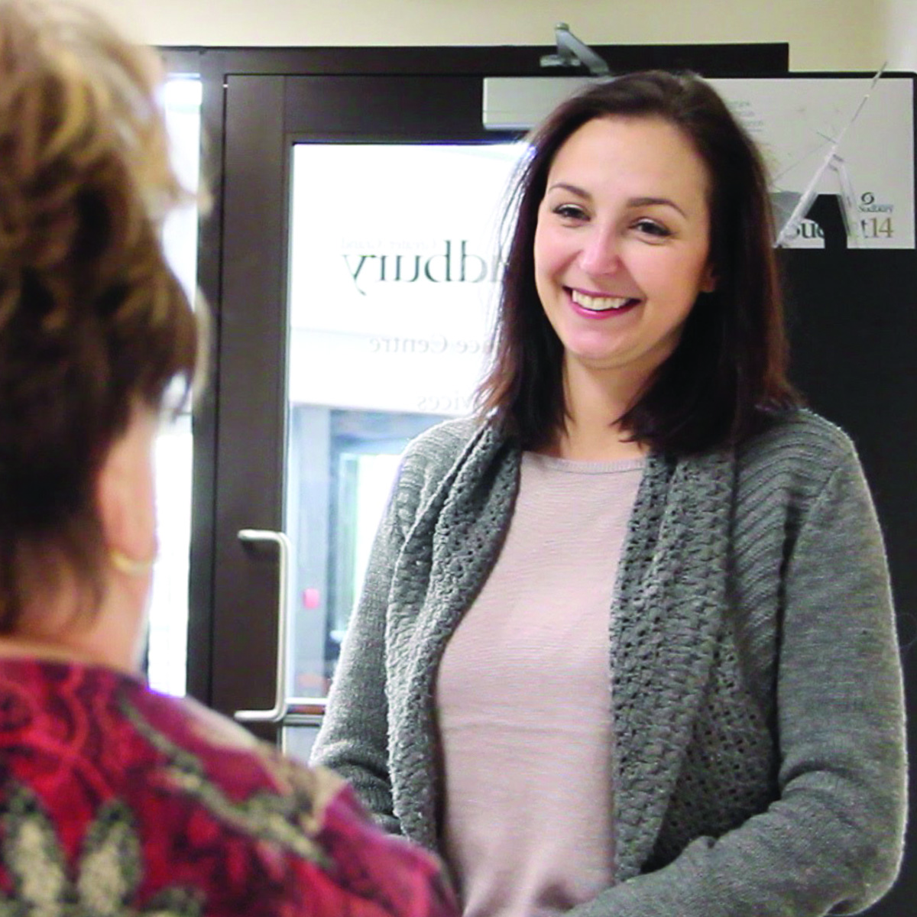
Our Mission
We recognize and appreciate our employees and ensure our staff receive the same level
of respect and commitment
they are expected to give to
the community.

Slide 7
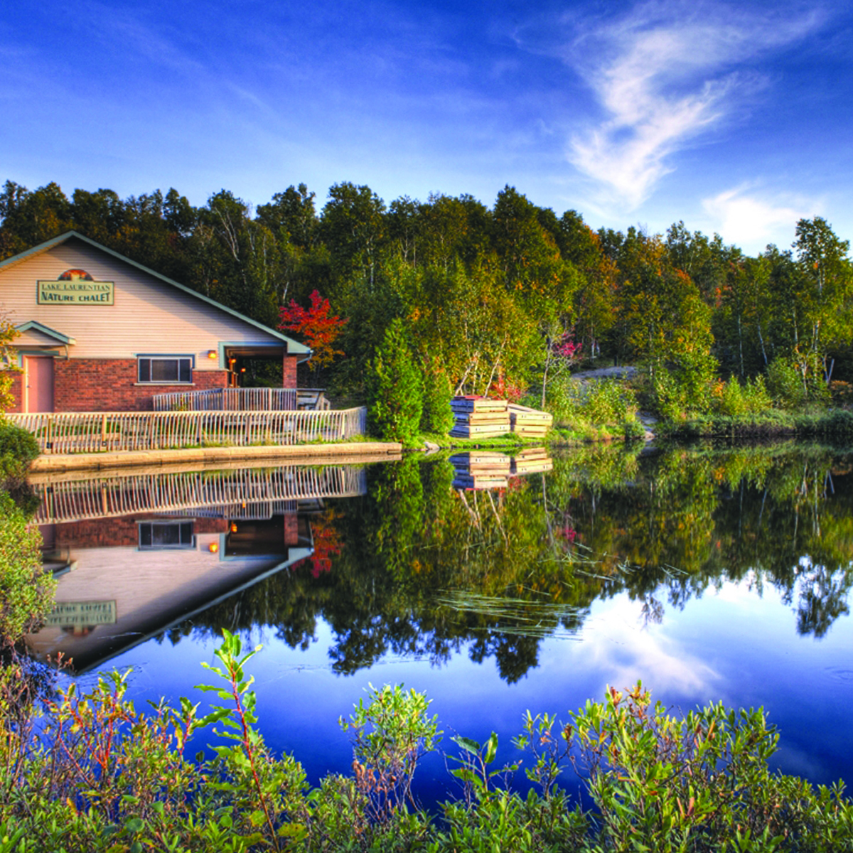
Our Mission
We are focused on fiscal, social and environmental responsibility
for current and future generations.
With trusted leadership and innovation, we provide resilient, dependable, accessible services and progressive policies that promote sustainable progress.

Slide 8

Our Mission
We work today to fulfill the needs
of all those who work, live, visit,
invest and play in our city.

Slide 9
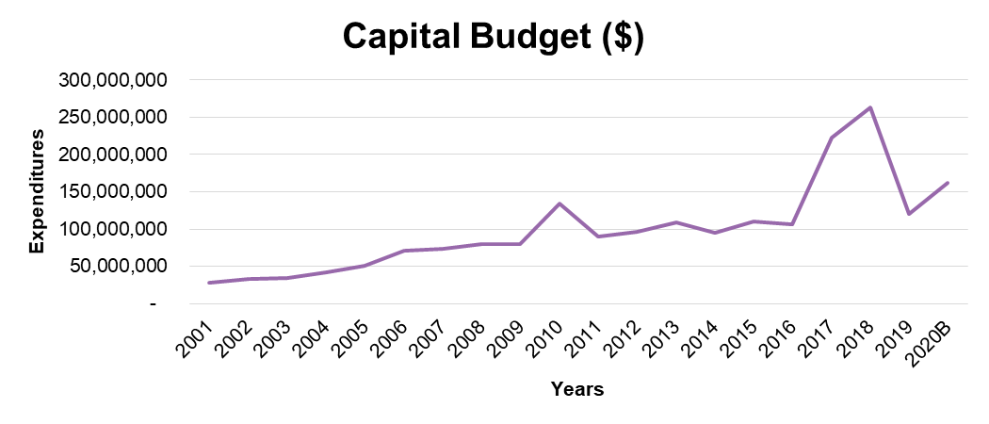
Capital Renewal Is Increasingly Important
Notes:
Emphasizes service performance and measurable results, aligned with Council’s strategic priorities
We do this because while choices about the cost of local government are very important, the reality is those choices reflect service expectations
Historically, there has been greater emphasis on spending and cost, without as much connection to performance. We’ve taken many steps to address this imbalance.
Information about performance provides important context, through the use of performance indicators and business plans, for understanding services and service levels
Describes how service efforts align with longer-term strategies like the Long-Term Financial Plan

Slide 10
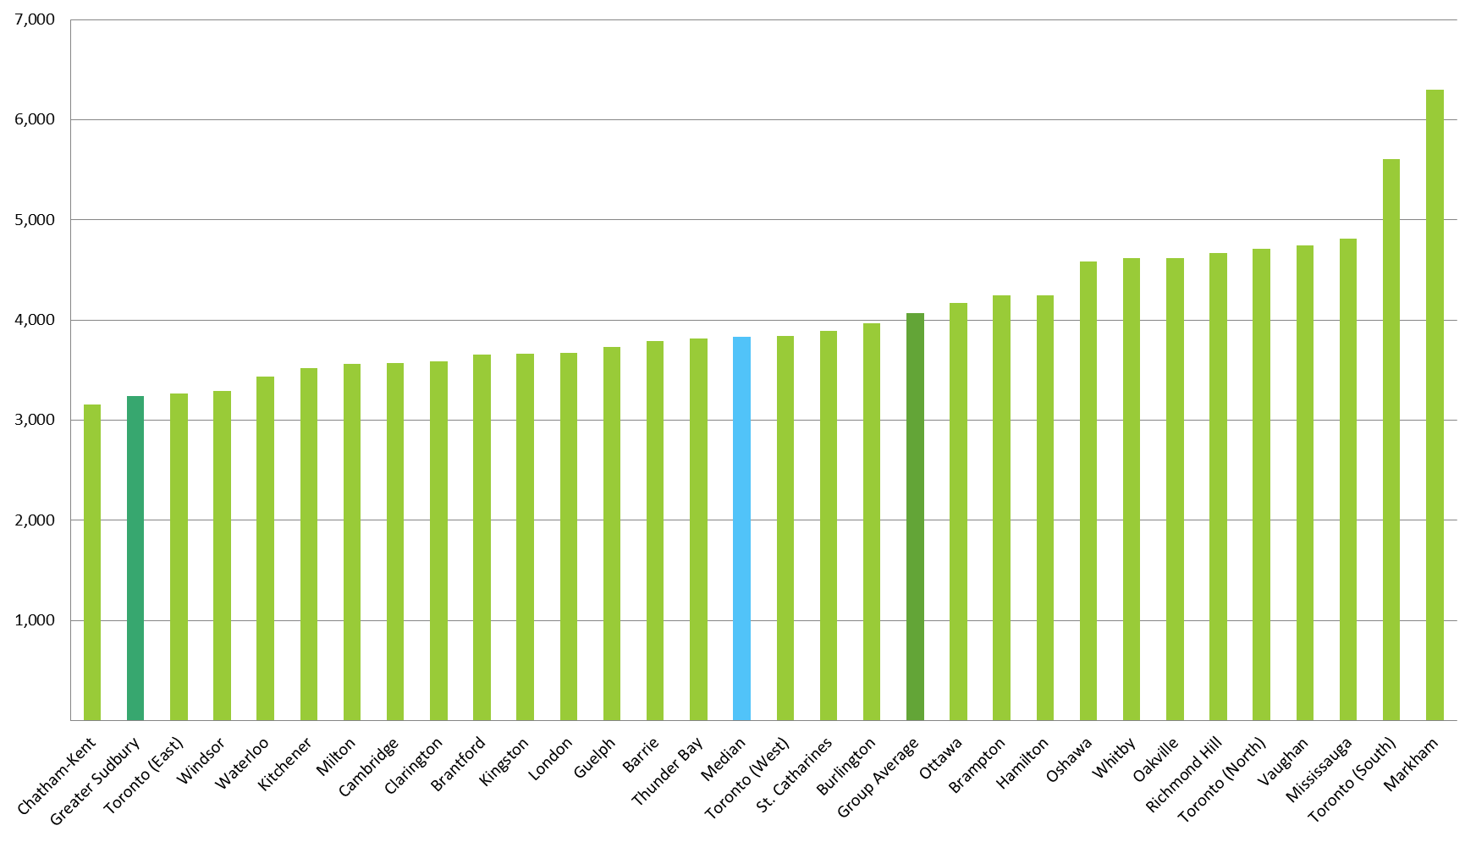
Greater Sudbury’s Property Taxes Are Among the Lowest in Ontario
2019 BMA Study (Draft)

Slide 11
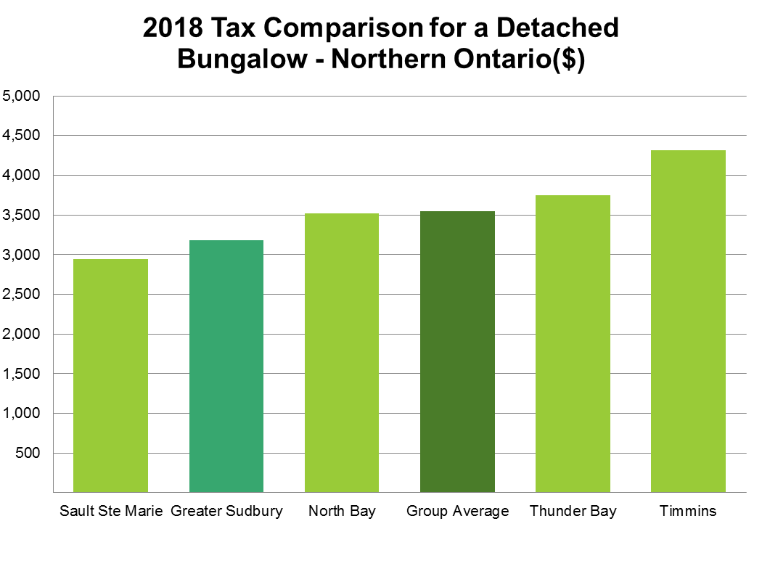
Greater Sudbury’s Property Taxes Are Among the Lowest In Northern Ontario
2019 BMA Study (Draft)

Slide 12
Comparisons to MBNCanada Median
Higher
Culture
EMS
Long Term Care
POA Admin
FOI Requests
Licensing
Payroll
Parks
Bylaw Enforcement
Social Housing
Police Services
Child Care
Legal
IT Services
Emergency Shelters
Social Assistance
Service
Level
General Admin
Accounts Payable
Water
Animal Control
Transit
Wastewater
Building Permits
Fire
Accounts Receivable
Parking
Human Resources
Waste Mgt
Planning
Investment Mgmt.
Purchasing
Facilities
Fleet
Recreation
Libraries
Roads
Lower
Higher
2018 MBNCanada
Efficiency

Slide 13

Where are We Going?
Council’s Strategic Priorities
Asset
Management
and Service
Excellence
Business
Attraction,
Development
and
Retention
Climate
Change
Economic
Capacity
and
Investment
Readiness
Housing
Create a
Healthier
Community
Strengthen
Community
Vibrancy

Slide 14
The Strategic Plan Guides Our Service Efforts
Workplan
May-June
PP&D
Jan-Feb
LRFP
Strategic Plan
Strategic Planning
Annual Planning
Official Plan
Budget
Mar-Oct
Other Master Plans
Program / Service
Delivery
Learning &
Adjusting
Performance Reporting
Measuring, Monitoring & Assessing Results
National Benchmarks
November
State of Assets
Sept
Variance Reports
Bi-monthly
Annual Report
May
Project Updates
Quarterly
Dashboards/
Scorecards
Quarterly (Jan, April, July, October)
Strat Plan Status
June
LRFP Update
May

Slide 15
Budget Pressures
Roads
maintenance
and winter
control
pressures
Provincial
funding
changes
Contractual
increases
Employee
Benefit and WSIB
changes
Utility
cost
changes
Service
Partners
Asset
condition
Assessment
Growth

Slide 16
Why Is The Budget Increasing?
3.5%
Municipal Services (+1.6%)
3.0%
Service Partner changes (+1.3%)
2.0%
Provincial govt changes (+0.6%)
The increase
is approximately
$46 per $100,000
of assessed
value
1.0%
0.0%

Slide 17
Base Budget
Reductions that were made to attain the 3.5% direction include:
Children
Services Mitigation Funding
$1.4 million
Contribution
to Capital
$3 million
Risk in
OMPF funding
$1 million
Salary
Gapping
$1 million
Reduction in Community
Safety
$600,000
Social
Services Discretionary Budget
Social
Planning
Council
Crossing
Guards
Reductions
worth more than
$7M required
to balance
the budget
Arenas

Slide 18




What Are You Buying?
Significant amount of Road work – half the capital budget
Substantial asset renewal work in other asset categories
Investments in technology to enable customer service improvements and more efficient daily service delivery
Concrete steps towards realization of Large Projects

Slide 19



What Are You Buying?
Services that support a community experiencing strong economic and employment growth
Increased responsiveness – more resources for winter control and new staff scheduling policies
Improved community resilience – water and wastewater projects that will improve service quality and reliability

Slide 20
2020 Projects Budget - $162.1M
Roads, winter road maintenance
and environment
Community health and well-being
Customer service and public
communications
Police
Technology and organizational support
Community safety

Slide 21


Business Cases for Service Level Changes
Provided as directed by Council resolutions
and/or proposed by staff
  $5.6M worth of proposals
Includes a small number of no cost/low cost business cases that should be approved

Slide 22
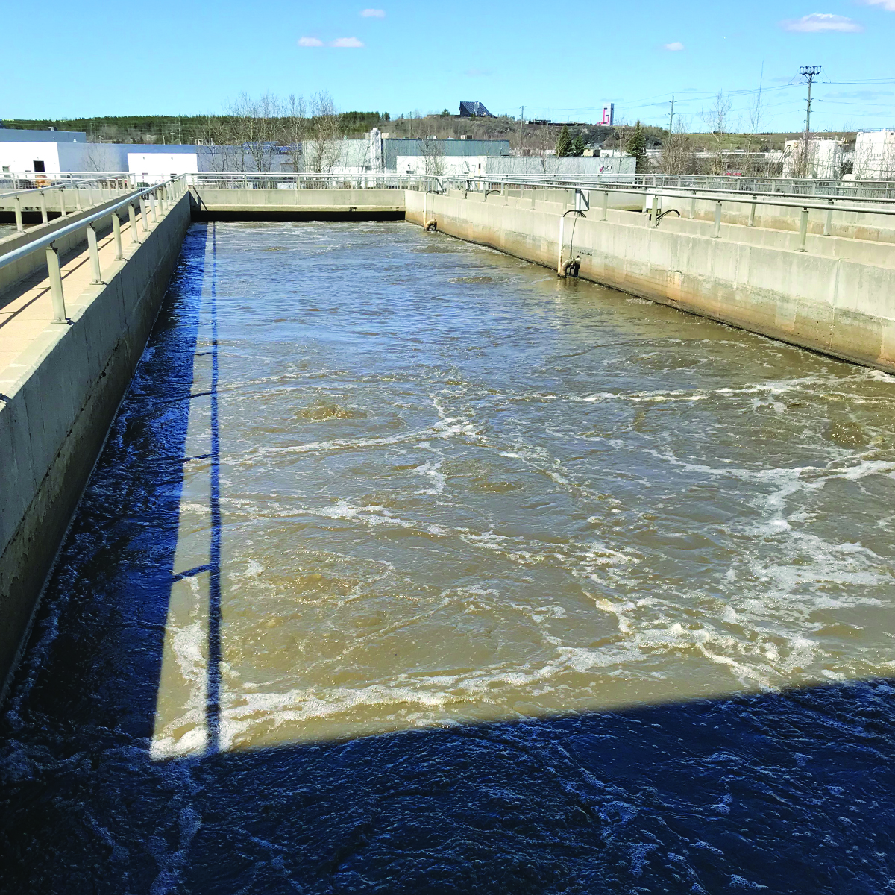
Water/Wastewater Budget
100% user-pay
Maintains current services
and service levels
Recommended rate increase
of 4.8%, consistent with the
long range financial plan
Annual impact
on a typical user (200 M³) - $61.50 or approximately $5.13/month

Slide 23
Service Partners
  Self-funded; no effect on tax levy
  6.7% increase over 2019 Budget;
  57% of its budget from the tax levy
  10% increase over 2019 Budget;
  30% of its budget from the tax levy
  4.9% increase over 2019 Budget;
  92% of its budget from the tax levy
  Currently reported as part of a divisional budget;
  anticipating this will change for 2021 Budget to reflect
  an evolving governance model

Slide 24
Why Propose This Plan?
  The 2020 Budget reflects our organizational values:
  Innovation
  Integrity
  Respect
  Foresight
  Trust
  Compassion
Notes:
Innovation
We continuously find improvements to meet our communities' changing needs.
Integrity
We are fair and consistent. We deliver on our promises and acknowledge our mistakes.
Respect
We show deep respect for everyone – employees, residents, and visitors – and for the communities in which they live.
Foresight
We act today in the interests of tomorrow.
Trust
Actions speak louder than words. We do what is right, always.
Compassion
We care about our residents, employees and businesses, and how they relate to our services. We find the right solutions for their needs

Slide 25


Options for Changing the Tax Levy
To be published as part of
the staff report containing
the motions to support
Finance & Administration
Committee’s deliberations
Options for a lower
tax levy change in
accordance with
Council’s direction

Slide 26
Next Steps
Council and Public Review
  Council Q&A November 19
Service Partner Budget Presentations November 19, 26
Finance & Administration Committee Meetings
  December 3
  December 4 (if needed)
  December 5 (if needed)
Council Approval December 10

